Slide 1
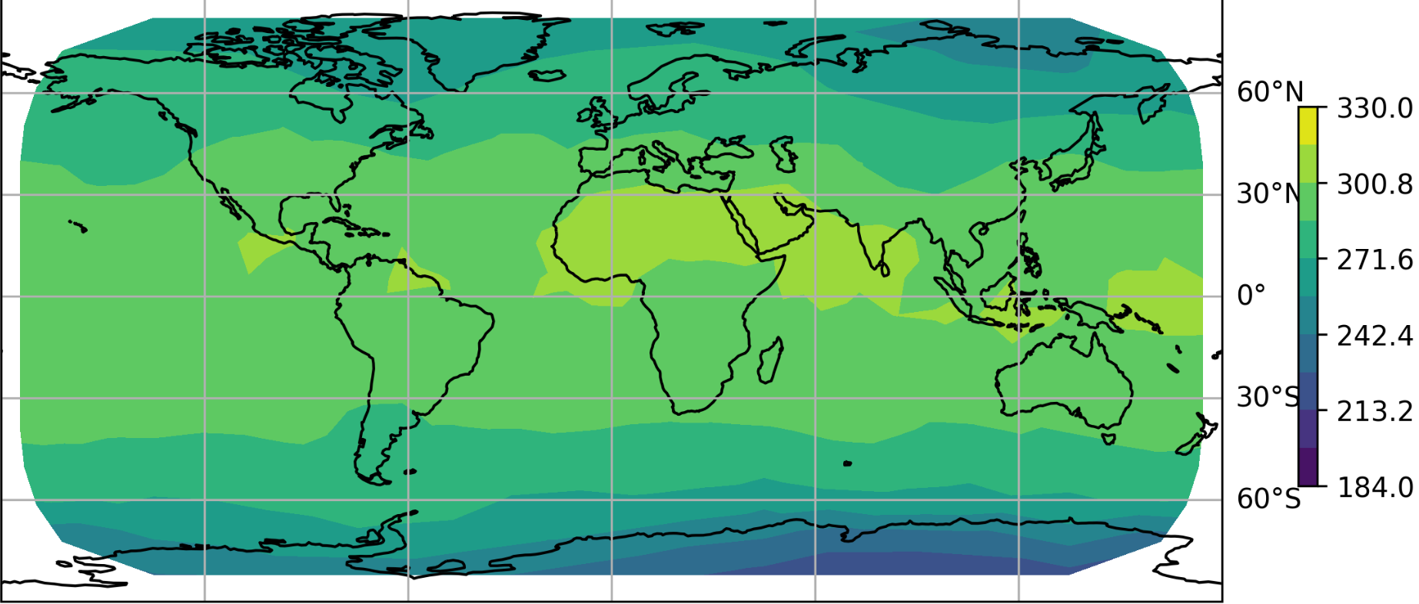

Adopting Physical Laws in ClimSim
Clark Kaminsky
Álvaro Vega Hidalgo

Slide 2
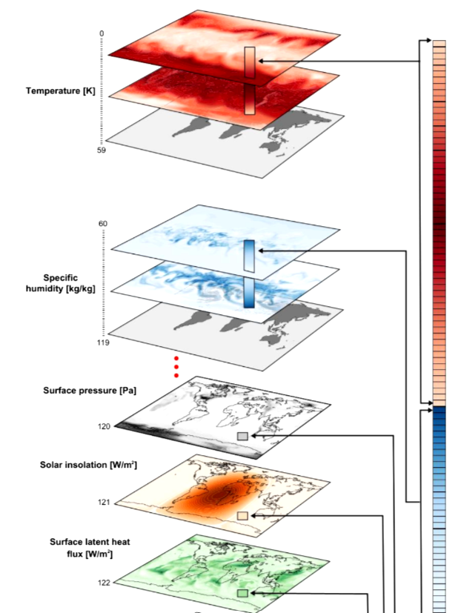
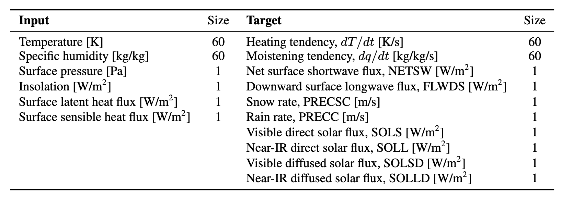
ClimSim Dataset:
High-resolution E3SM (Energy Exascale Earth System Model) climate simulations
20-minute intervals over 10 simulated years
High resolution: 1.5° x 1.5° horizontal grid (41.2 TB)
Low-resolution: 11.5° x 11.5° (744 GB)
Notes:
Motivation – predicting weather phenomena and temperature fluctuations that impact humans and wildlife

Slide 3
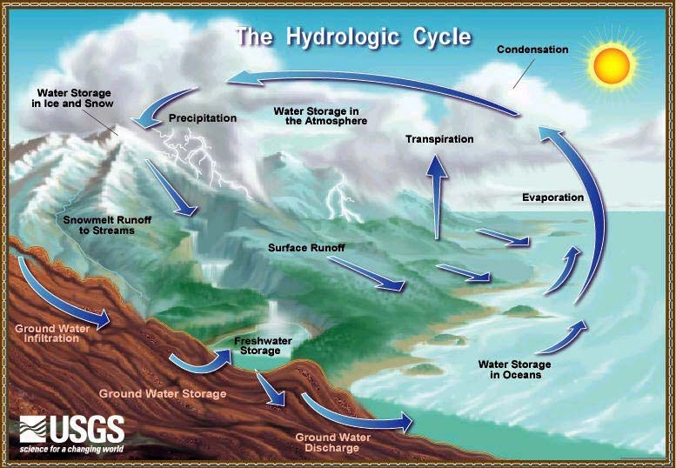
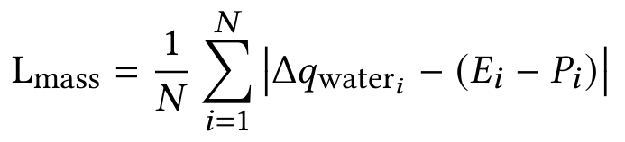
Conservation of Water Mass:
Maintain the net water mass balance between Earth’s surface and the atmosphere:
Water is simply transported across the globe through different phases, not created or destroyed
change in specific humidity
precipitation rate
evaporation rate

Slide 4
Conservation of Water Mass:
Maintain the net water mass balance between Earth’s surface and the atmosphere:
Water is simply transported across the globe through different phases, not created or destroyed
If precipitation is higher than evaporation, specific humidity should decrease equivalently
change in specific humidity
precipitation rate
evaporation rate

Slide 5
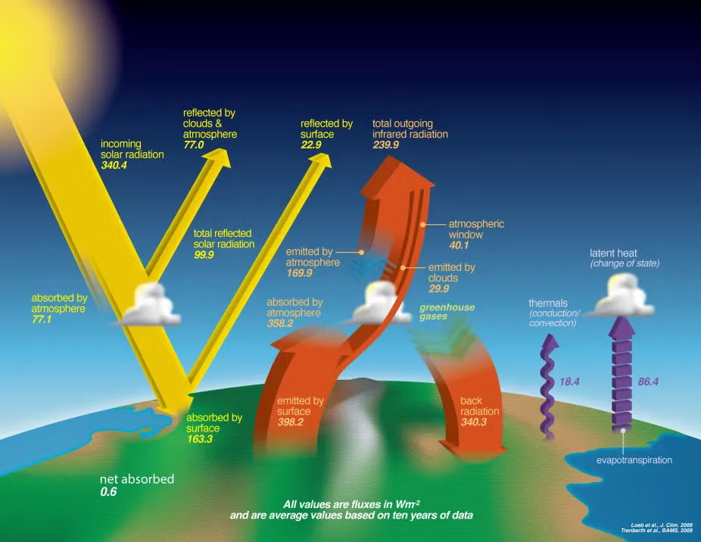
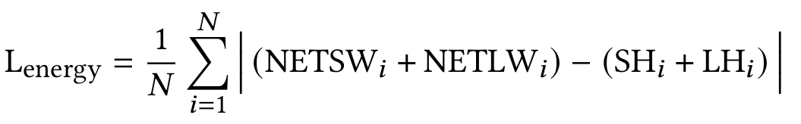
Conservation of Energy:
Maintain the net energy balance at the Earth’s surface:
Incoming shortwave and longwave radiation = surface fluxes

Slide 6
Conservation of Energy:
Maintain the net energy balance at the Earth’s surface:
Incoming shortwave and longwave radiation = surface fluxes
Latent heat flux – energy required for the phase change of water
Sensible heat flux – energy moved from difference between the surface and air temperature

Slide 7
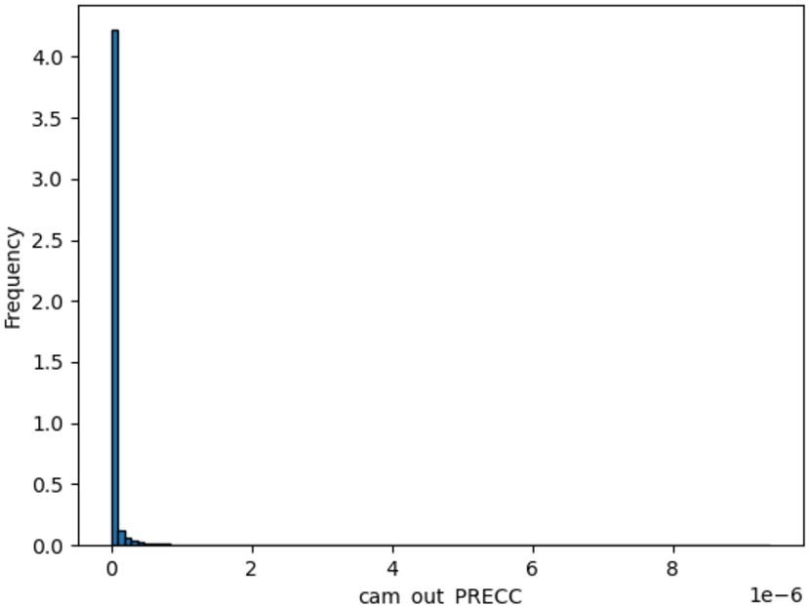
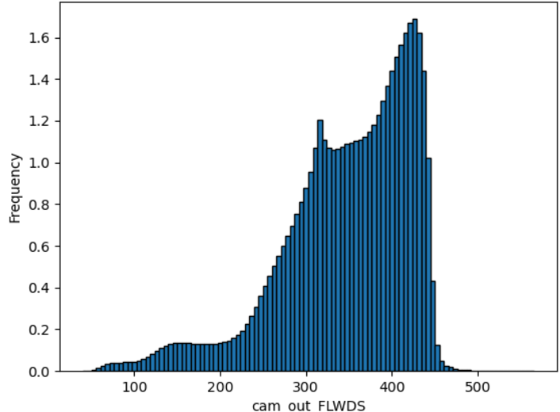
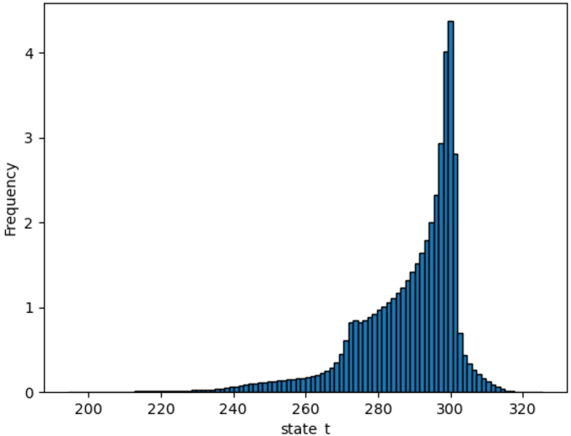
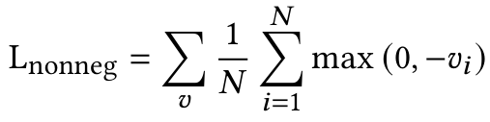

Non-negativity Constraints:
We want to constrain variables to the positive domain when we know they can never be negative:
Notes:
AVH

Slide 8
Non-negativity Constraints:
We want to constrain variables to the positive domain when we know they can never be negative:
Ex: snow rate, rain rate, specific humidity, or temperature (°K) are all guaranteed to be greater than 0 – we want our model’s loss to be higher if it predicts these terms to be negative.
Notes:
Precipitation, temperature, longwave radiation

Slide 9
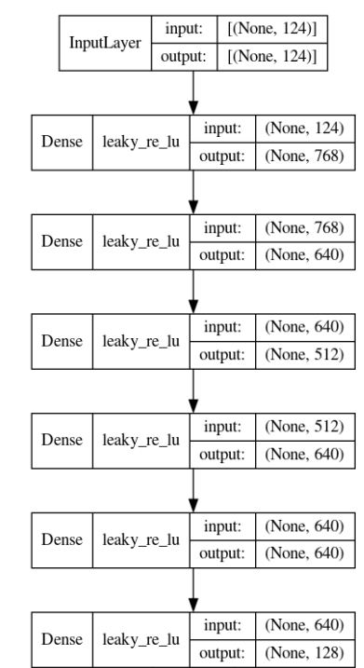
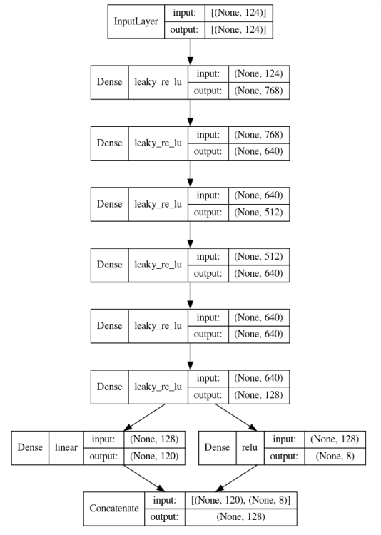
Multi-layer Perceptron:
Used the best hyperparameter configuration from the ClimSim analysis – 5 layers with nodes [768, 640, 512, 640, 640], LeakyReLU activation, and RAdam optimizer.

Slide 10
Multi-layer Perceptron:
Our changes:
Excluded some multilevel variables to reduce computational time and memory requirements

Slide 11
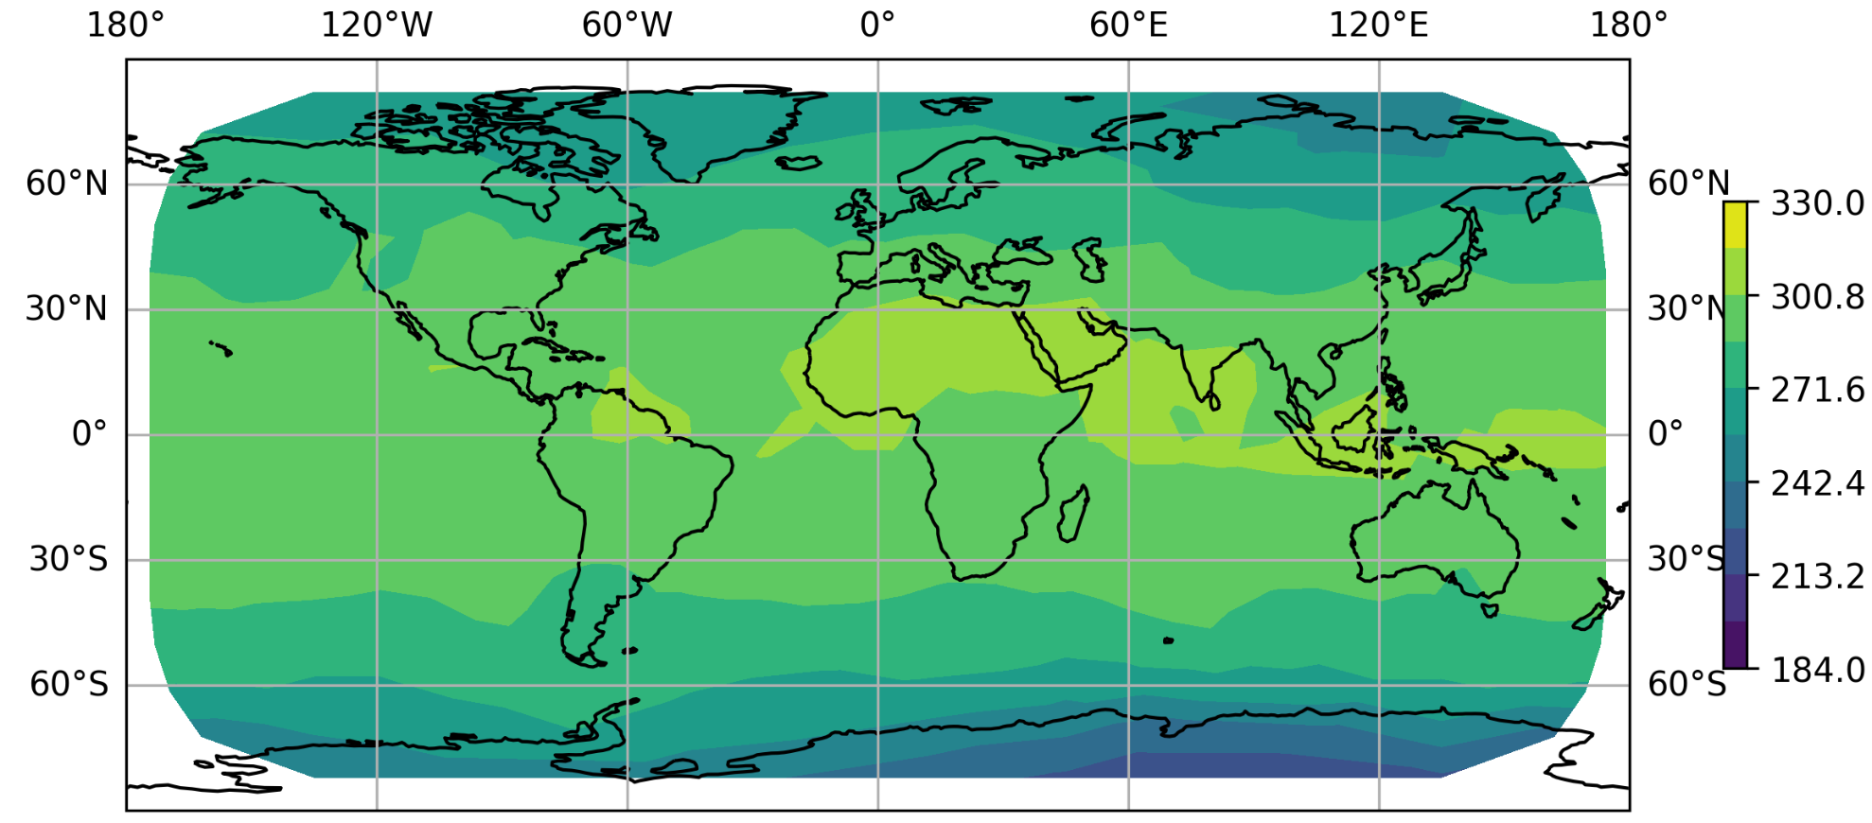
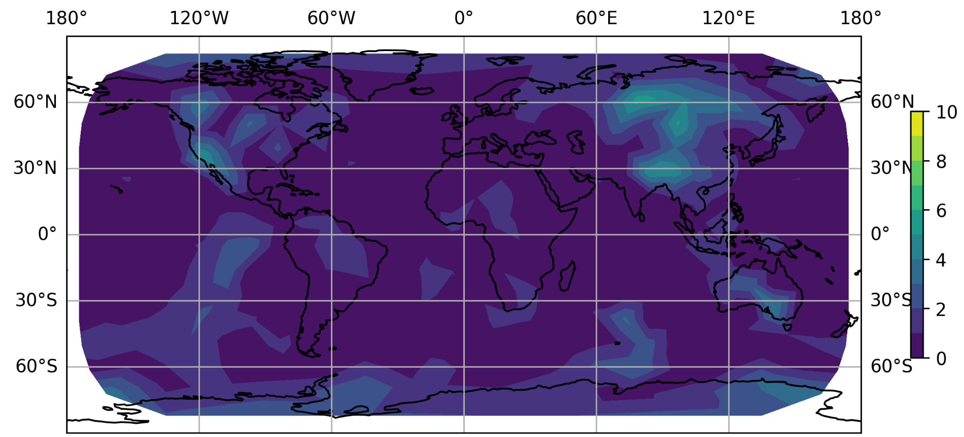
Temperature Prediction Example:
Surface Temperature (K) Prediction for May 1:
Absolute error for predictions:
Notes:
CK

Slide 12
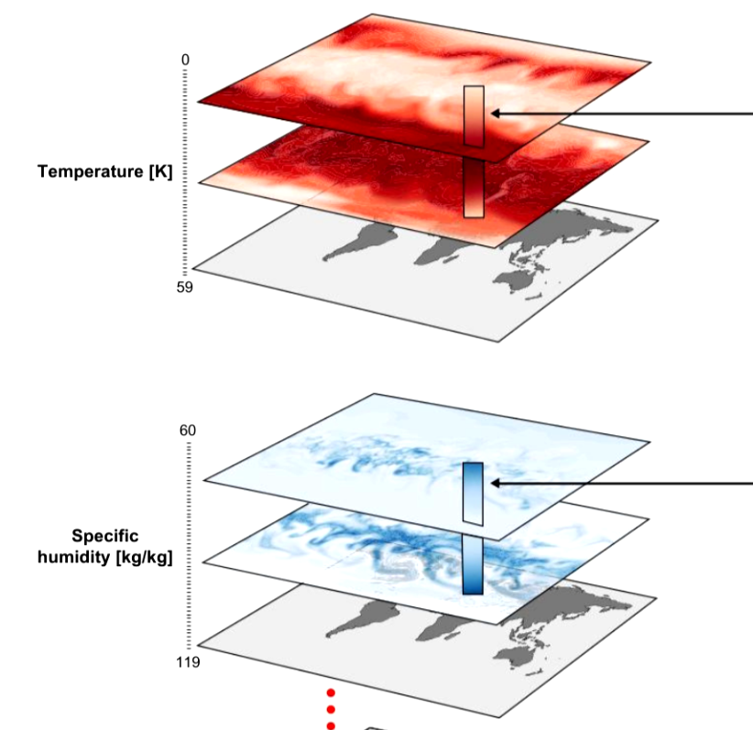
Methods (preprocessing):
Task: predicting output variables (temperature, rain rate, specific humidity) at each of 384 global locations 20 minutes in the future
Preprocessing:
Normalized the variables for training stability
Subsampled multilevel variables to 1 altitude level (surface) instead of 60, used only 1% of the available low resolution dataset

Slide 13
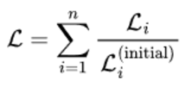

Methods (loss incorporation):
Task: predicting output variables (temperature, rain rate, specific humidity) at each of 384 global locations 20 minutes in the future
Incorporate physics-informed losses: balance, then multiply each with scaling factors (λ)
Balancing multiple loss functions:
Estimate the initial loss with the first few batches, scale each loss value with the reciprocal of its initial value

Slide 14
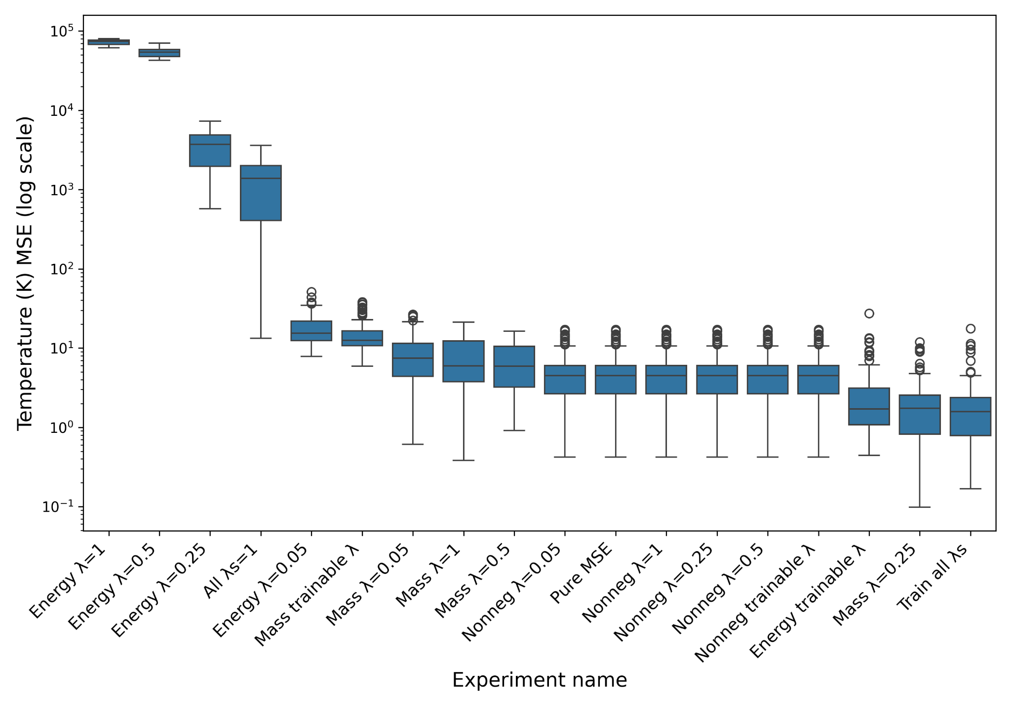
Results:
Baseline MLP (‘PureMSE’) uses only data loss to guide its optimization, and performs relatively well
Notes:
AVH

Slide 15
Results:
Baseline MLP (‘PureMSE’) uses only data loss to guide its optimization, and performs relatively well
Incorporating all of the loss terms yields a significant improvement over the baseline

Slide 16
Results:
Baseline MLP (‘PureMSE’) uses only data loss to guide its optimization, and performs relatively well
Incorporating all of the loss terms yields a significant improvement over the baseline
Non-negativity constraint is never worse than the baseline

Slide 17
Results:
Baseline MLP (‘PureMSE’) uses only data loss to guide its optimization, and performs relatively well
Incorporating all of the loss terms yields a significant improvement over the baseline
Non-negativity constraint is never worse than the baseline
Still have to look into why some trainable scaling factors were worse than setting explicitly (see water mass conservation λ = .25)

Slide 18
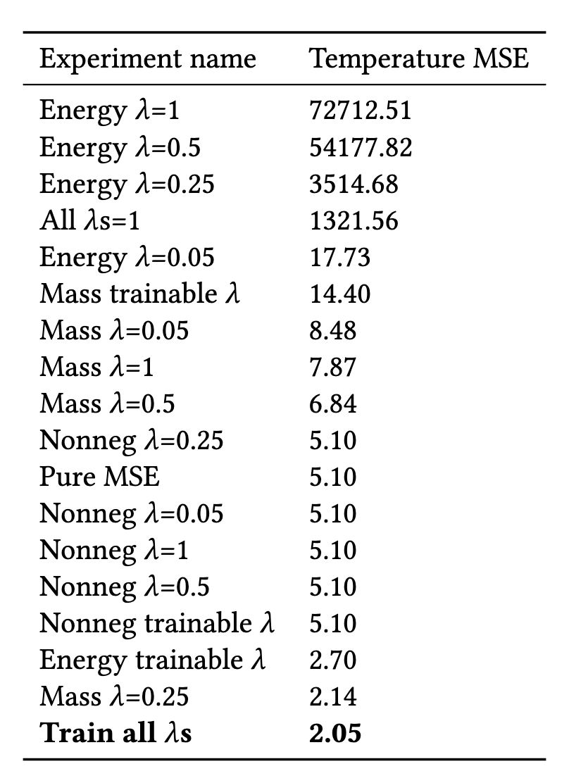
Results:
Baseline MLP (‘PureMSE’) uses only data loss to guide its optimization, and performs relatively well
Incorporating all of the loss terms yields a significant improvement over the baseline
Non-negativity constraint is never worse than the baseline
Still have to look into why some trainable scaling factors were worse than setting explicitly (see water mass conservation λ = .25)

Slide 19
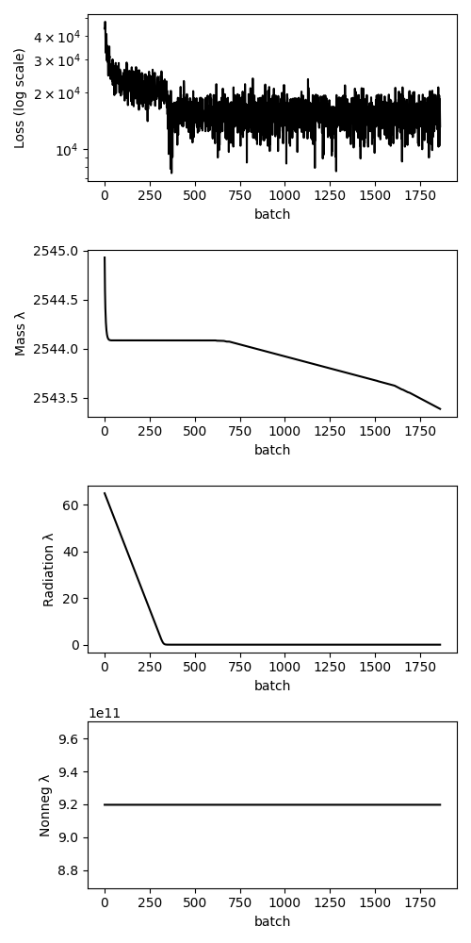
Loss and learnable scaling factor:
Both water conservation and non-negativity constraints learned to use a high scaling factor, greatly outweighing the data loss
Energy (radiation) scaling factor was brought down to nearly 0

Slide 20
Prediction over one full day (Feb 2):
Notes:
CK – this used an older model and is not very accurate, not sure if i should still include

Slide 21
Conclusions
Including trainable scaling factors for radiation, mass, and non-negativity loss landed the best performance, improving predictions over solely data loss
Performing experiments with physical losses in the ClimSim dataset opens a lot of questions:
When do these losses perform well, and when do they actually hurt our model?
Data loss performs almost too well in our task (predicting output variables only 20 minutes in the future) → longer forecast window might be more interesting, where our physics-informed losses could take over

Slide 22
References
References
[1] Josh Cowls, Andreas Tsamados, Mariarosaria Taddeo, and Luciano Floridi. 2023. The AI gambit: leveraging artificial intelligence to combat climate change—opportunities, challenges, and recommendations. Ai & Society (2023), 1–25.
[2] Sungduk Yu, Walter Hannah, Liran Peng, Jerry Lin, Mohamed Aziz Bhouri, Ritwik Gupta, Björn Lütjens, Justus C. Will, Gunnar Behrens, Julius Busecke, Nora Loose, Charles Stern, Tom Beucler, Bryce Harrop, Benjamin Hillman, Andrea Jenney, Savannah L. Ferretti, Nana Liu, Animashree Anandkumar, Noah Brenowitz, Veronika Eyring, Nicholas Geneva, Pierre Gentine, Stephan Mandt, Jaideep Pathak, Akshay Subramaniam, Carl Vondrick, Rose Yu, Laure Zanna, Tian Zheng, Ryan Abernathey, Fiaz Ahmed, David Bader, Pierre Baldi, Elizabeth Barnes, Christopher Bretherton, Peter Caldwell, Wayne Chuang, Yilun Han, YU HUANG, Fernando Iglesias-Suarez, Sanket Jantre, Karthik Kashinath, Marat Khairoutdinov, Thorsten Kurth, Nicholas Lutsko, Po-Lun Ma, Griffin Mooers, J. David Neelin, David Randall, Sara Shamekh, Mark Taylor, Nathan Urban, Janni Yuval, Guang Zhang, and Mike Pritchard. 2023. ClimSim: A large multi-scale dataset for hybrid physics-ML climate emulation. In Advances in Neural Information Processing Systems, A. Oh, T. Naumann, A. Globerson, K. Saenko, M. Hardt, and S. Levine (Eds.), Vol. 36. Curran Associates, Inc., 22070–22084. https://proceedings.neurips.cc/paper_files/paper/2023/file/45fbcc01349292f5e059a0b8b02c8c3f-Paper-Datasets_and_Benchmarks.pd

Slide 23
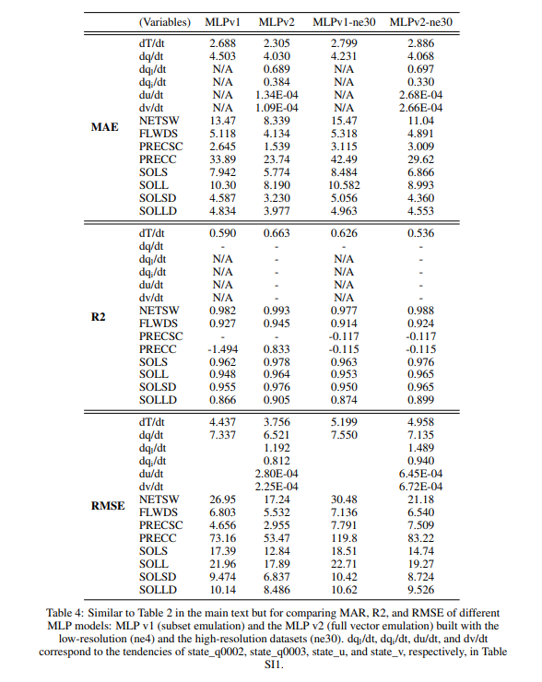
Appendix
ClimSim baseline results:

